Slide 1
Part 01
Present Worth Analysis

Slide 2
01.
Introduction to Present Worth Analysis
What is PW Analysis?
Present Worth (PW) Analysis converts all cash flows to their equivalent value at time zero (present). This allows direct comparison of alternatives.
Formula:
NPW(净现值） = PW(Benefits) - PW(Costs)
When to Use PW Analysis
1.Comparing alternatives with equal lives(choose the larger one)
2.Finding today's value of future cash flows
3.Bond pricing and valuation
4.Project feasibility analysis(NPW>0,可投资）

Slide 3
Economic Criteria

Slide 4
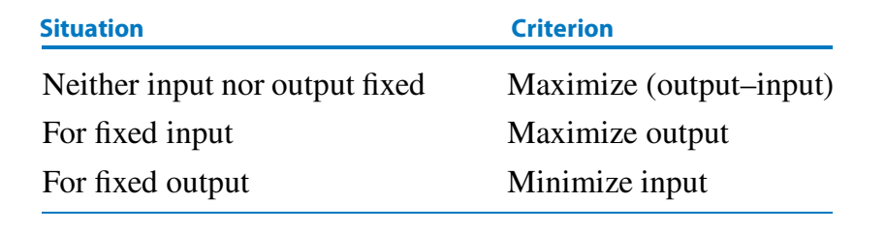
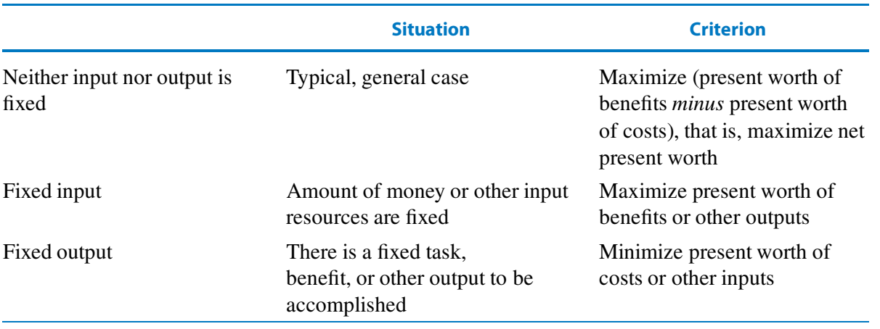
Criteria

Slide 5
Situation 1: Neither Input nor Output Fixed
When both costs and benefits vary among alternatives, maximize the net present worth.
NPW = PW(Benefits) - PW(Costs)
NPW越大，项目纯收入越高，选择NPW最大的方案
Situation 2: Fixed Input (Budget)
When the budget is fixed, maximize the present worth of benefits.
Given: Cost = Constant
成本相同，选择PW(收益）最大的方案
Situation 3: Fixed Output (Required Task)
When the output is fixed, minimize the present worth of costs.
Given: Benefit = Constant
收益相同，选择PW(成本）最小的方案

Slide 6








Part 02
PW Analysis with Equal Lives and
PW Analysis with Different Lives

Slide 7
01.
Example: Machine Selection
Compare two machines with 5-year lives at 7% interest:
Machine A:
Cost: $1,000
Annual savings: $300
Machine B:
Cost: $1,350
Annual savings: $300 + $50/year
Solution
Machine A:
NPWₐ = -1000 + 300(P/A, 7%, 5)
NPWₐ = -1000 + 300(4.100)
NPWₐ = -1000 + 1,230
NPWₐ = $230
Machine B:
NPWʙ = -1350 + 300(P/A, 7%, 5) + 50(P/G, 7%,5)
NPWʙ = -1350 + 300(4.100) + 50(7.647)
NPWʙ = -1350 + 1,230 + 382
NPWʙ = $262
Decision: Select Machine B (Higher NPW)

Slide 8

02.
The Problem
Method 1: Least Common Multiple
Use the LCM of the lives as the analysis period. Assume identical replacement.
Example: LCM(6, 9) = 18 years
Machine A replaced 2 times
Machine B replaced 1 time
Method 2: Specified Study Period
Use a required project duration and estimate terminal (salvage) values.
Example: 10-year study period
Estimate salvage value at year 10
Include in PW calculation
Cannot directly compare alternatives with different lives. Need a common analysis period.
Example:
Machine A: 6-year life
Machine B: 9-year life

Slide 9
03.Solution
Method1:
PW_{A}
=P_{A} + (P_{A} + F_{A})(P/F,10%,6) + (P_{A} + F_{A})(P/F,10%,12) + A_{A}(P/A,10%,18) - F_{A}(P/F,10%,18)
= -10000 + (-10000+1000)*0.5645 + (-10000+1000)*0.3186 + (-2000)*8.2014 - 1000*0.1799
= -34530.6元
PW_{B}
=P_{B} + (P_{B} + F_{B})(P/F,10%,9) + A_{B}(P/A,10%,18) - F_{B}(P/F,10%,18)
= -15000 + (-15000+2000)*0.4241 + (-1500)*8.2014 - 2000*0.1799
= -33175.2元 <PW_{A}
Method2:
PW_{A}
= P_{A} + A_{A}(P/A,10%,6) + F_{A}(P/F,10%,6) + (P_{A} + A_{A}(P/A,10%,4))(P/F,10%,6) + F_{A,10}(P/F,10%,10)
= -10000 + (-2000)*4.3553 + 1000*0.5645 + (-10000 - 2000*3.1699)*0.5645 + 7000*0.3855
=-24661.4元
PW_{B}
= P_{B} + A_{B}(P/A,10%,9) + F_{B}(P/F,10%,9) + A_{B}(P/F,10%,9) + F_{B,10}(P/F,10%,10)
= -15000 + (-1500)*5.7590 + 2000*0.4241 + (-1500)*0.4241 + 3000*0.3855 *
= -22270元 <PW_{A}
So select Machine B

Slide 10
Part 03
Practice Problems

Slide 11
Capitalized Cost

Slide 12
Define and calculate the capitalized cost of a perpetual project.
Definition:
Capitalized Cost is the present worth of a perpetual cash flow (infinite analysis period).
Used for permanent infrastructure, endowments, and ongoing maintenance.
Formula:
P = A / i
Label each variable:
P = Capitalized cost (present worth)
A = Annual perpetual payment

Slide 13
When to Use Capitalized Cost
Common Applications
Bullet points:
Endowments: Funding perpetual scholarships or grants
Infrastructure: Permanent roads, bridges, dams
Maintenance: Forever annual upkeep costs
Public Projects: Long-term government investments
输入标题

Slide 14
Example Calculation
Calculate the capitalized cost for a bridge that requires $100,000 annual maintenance. Interest rate is 6%.
Solution steps:
1. Given: A = $100,000, i = 6% = 0.06
2. Formula: P = A / i
3. Calculation: P = 100,000 / 0.06 = $1,666,667
Interpretation:
$1.67M invested at 6% generates $100K/year forever to cover maintenance.

Slide 15

Machine Comparison
Project Evaluation
Capitalized Cost
Bond Pricing

Slide 16
Problem 1：Machine Comparison
Two machines are being considered:
Machine X: Cost $8,000, annual benefit $2,500, life 4 years
Machine Y: Cost $12,000, annual benefit $3,500, life 6 years
Using PW analysis at 10% interest, which machine should be selected?
X: -8000 + 2500(P/A,10%,4) = -75.34
PWx= -75.34 * [1+(P/F,10%,4)+(P/F,10%,8)] =-75.34*2.1495 = -161.94
Y: -50000 + 12000(P/A,12%,8) = 3242.41
PXy = 3243.41[1+(P/F,10%,6)] = 5074.23
选Y

Slide 17
Problem 2：Project Evaluation
A project requires an initial investment of $50,000 and will generate annual benefits of $12,000 for 8 years.
At 12% interest, what is the net present worth? Should the project be undertaken?
NPW = -50,000 + 12,000(P/A, 12%, 8）
NPV = -50000 + 12000（P/A，12%，8）
（P/A，12%，8）=4.96764
NPV = -50000 + 12000*4.96764 = 9611.68
NPV > 0
项目可行
输入标题

Slide 18
Problem 3：Capitalized Cost
Calculate the capitalized cost for a bridge that requires $100,000 annual maintenance. Interest rate is 6%.
Use: P = A/i
P = A/i
= 100000/0.06
= 1666666.67

Slide 19
Problem 4：Bond Pricing
A bond with face value $1,000 pays $40 interest semiannually and matures in 10 years. If the market interest rate is 12% compounded semiannually, what is the present worth (price) of the bond?
PW = 40(P/A, 6%, 20) + 1000(P/F, 6%, 20）
i = 6% n = 20
年利息40 面值 1000
PW = 40(P/A, 6%, 20) + 1000(P/F, 6%, 20）
= 40*11.4699 + 1000*0.3118
=770.596

Slide 20
Part 4
Key takeaways

Slide 21
01.
Session Summary: Present Worth & Cost Analysis
Key Takeaways
1. Present Worth (PW) Analysis
Core idea: Convert all future cash inflows/outflows to their present value at a common discount rate.
Net Present Worth (NPW): NPW = PW(Benefits) - PW(Costs)
Use case: Compare alternatives with different cash flow timelines on a comparable basis.
2. Economic Decision Criteria
Profit-focused projects: Maximize NPW or Present Worth of benefits.
Cost-focused projects: Minimize Present Worth of costs.
Rule: Select the alternative with the most favorable NPW based on project type.
3. Capitalized Cost
Formula: P = A/i
Definition: Present worth of an infinite (perpetual) series of equal annual payments.
Use case: Permanent projects, endowments, or assets with indefinite service life.

Slide 22
Next Session Preview
• Annual Cash Flow Analysis
Use EUAC (Equivalent Uniform Annual Cost) and EUAB (Equivalent Uniform Annual Benefit) to compare alternatives on an annualized basis.
• Capital Recovery Concepts
Cover loan amortization, equipment replacement analysis, and calculating annual cost of owning an asset.

