Slide 1








Part 01
Compound Interest

Slide 2




01.Compound Interest Formula F = P(1 + i)ⁿ F = Future value ($) P = Principal ($) i = Interest rate per period (decimal) n = Number of periods
DW

Slide 3


Problem: $1,000 invested at 8% compounded annually for 5 years. What is the future value? Solution: F = P(1 + i)" P = $1,000, i = 8% = 0.08, n = 5 F = 1000(1.08)⁵ F = 1000 × 1.4693 = $1,469.33 Interest earned: $1,469.33 - $1,000 =$469.33

Slide 4



02. Finding Equivalencevalues | Futurevalue: F=P(1+i) presentvalue: P=F/(1 +i) Example: At 10% compound interest,what amount in 3years is equivalent to $2,000 today? P=$2,000, i= 10%,n=3 F=P(1+i)=2000 X 1.331=$2,662
DW

Slide 5

Compound amount Factor(F/P)&Present Worth Factor(P/F) F = P(F/P, i, n) & P = F(P/F, i, n) which is dimensionally correct. Without proceeding further, we can see that when we derive a compound interest factor to find a present sum P, given a future sum F, the factor will be (P/F, i, n); so, the resulting equation would be P = F(P/F, i, n)
DW

Slide 6
Part 02

Slide 7
01.
Factor Relationships
Reciprocal Relationship
Using Interest Tables
The F/P and P/F factors are reciprocals of each other:
(P/F, i, n) = 1/(F/P, i, n)
Locate Table
Find the table for your interest rate (e.g., 8% table)
Example at 8%, n=5:
(F/P, 8%, 5) = 1.4693
(P/F, 8%, 5) = 0.6806
Find Period
Check: 1/1.4693 = 0.6806 ✓
Locate the row for your time period (n)
Summary Table
3
Read Factor
Given | Find | Factor
P | F | (F/P)
F | P | (P/F)
Read the factor value from the appropriate column
Calculate
Multiply the known amount by the factor

Slide 8

02.
Interpolation for Non-Tabulated Rates
When to Use Interpolation
Calculator Methods
When the exact interest rate is not in the tables (e.g., 7.5%), use linear interpolation between the two closest rates.
Financial Calculator
Use TVM (Time Value of Money) functions:
Interpolation Formula:
• Enter P, i, n → Solve for F
• Enter F, i, n → Solve for P
Factor = Factor₁ + [(i - i₁)/(i₂ - i₁)] × (Factor₂ - Factor₁)
Excel/Spreadsheet
Interpolation Example
Use built-in functions:
• FV(rate, nper, pmt, pv) for F/P
Find (F/P, 7.5%, 6):
• PV(rate, nper, pmt, fv) for P/F
Given: (F/P, 7%, 6) = 1.5007
(F/P, 8%, 6) = 1.5869
Direct Formula
Factor = 1.5007 + (0.5/1) × (1.5869 - 1.5007)
Use the formulas directly with any calculator:
= 1.5007 + 0.5 × 0.0862
• F = P(1+i)ⁿ
= 1.5438
• P = F/(1+i)ⁿ

Slide 9
Part 03
Practice Problems

Slide 10
01.
Find the future value using F/P factor:
a) P = $2,500, i = 7%, n = 6 years
b) P = $4,000, i = 9%, n = 8 years
c) P = $1,500, i = 6%, n = 10 years
a)F=2500*(1+0.07)^6 = 2500*1.50073035=$3,751.83
b)F =4000* (1+0.09)^8 = 4000*1.99256264 =$7,970.25
c)F = 1500*(1+0.06)^10= 1500* 1.790847697 =$2,686.27

Slide 11
02.
Find the present worth using P/F factor:
a)F = $5,000, i = 8%, n = 4 years
b)F = $8,000, i = 10%, n = 7 years
c)F = $12,000, i = 5%, n = 12 years
(P/F,8%,4)=1/1.08^4=0.7350
P=5000×0.7350= 3675.15
(P/F,10%,7)=1/1.1^7=0.5132
P=8000×0.5132= 4105.26
(P/F,5%,12)=1/1.05^12=0.5568
P=12000×0.5568= 6681.21

Slide 12

03.
Key Takeaways
A company expects to receive $8,000 in 6 years. What is the present value at 9% interest?
F/P Factor
F = P(F/P, i, n) = P(1+i)ⁿ. Converts present to future value.
(Use P/F factor to find today's equivalent value)
P/F Factor
P = F(P/F, i, n) = F/(1+i)ⁿ. Converts future to present value.
P= 8000 *1/(1+0.09)^6= 8000 *1/1.677100119=8000 *0.596267 =$4,770.14
Reciprocals
(P/F, i, n) = 1/(F/P, i, n). Factors are reciprocals of each other.
If you invest $3,000 today, how much will you have in 10 years at 7% compound interest?
(Use F/P factor to calculate future value)
F = 3000 *(1+0.07)^10= 3000 *1.967151357=$5,901.45

Slide 13
Part 04

Slide 14



01.Factor Classification
A fundamental framework for engineering economic analysis of uniform series
Compound Amount
Factor (F/A)
Sinking Fund
Factor (A/F)
Other Related
Uniform Series Factors
Used to calculate the future value of an equal-payment series, reflecting the time value of money. This factor converts equal periodic payments into a future lump sum.
Calculates the required equal periodic deposits to achieve a future target amount. It helps establish a regular savings plan to ensure future funding needs are met.
Includes Present Worth Factor (P/A) for present value calculations and Capital Recovery Factor (A/P) for annuity recovery analysis. Together they form a complete system.
Core Tool for Future Value
Planning for Future Goals
Complete Analysis System
Notes:
Let's begin by classifying the key factors we'll be using. First, the Compound Amount Factor, which helps us find the future value of a series of equal payments. Second, the Sinking Fund Factor, which tells us how much we need to save periodically to reach a future goal. Finally, we'll touch on other related factors like Present Worth and Capital Recovery, which are essential for a complete financial analysis.

Slide 15
01.Definition and Formula
ENGINEERING ECONOMIC ANALYSIS
Factor Definition
Formula Derivation
The Compound Amount Factor (F/A, i%, n) represents the future value F of an equal-payment series A at an interest rate i% for n periods. The formula is F = A × (F/A, i%, n), where (F/A, i%, n) is the factor value calculated based on the interest rate and number of periods.
Derived from the compound interest formula, it considers the compound growth of each periodic payment. By summing the future values of all periodic payments, a unified future value calculation formula is formed, simplifying the complex calculation process.
Factor Tables
Calculation Method
Using pre-calculated factor tables allows direct lookup of the (F/A, i%, n) value based on the given interest rate and number of periods, improving calculation efficiency and accuracy. This is a commonly used tool in engineering economic analysis.
To calculate the future value F using the formula or factor tables, it is necessary to clearly define the equal payment A, interest rate i, and number of periods n. Ensure data accuracy to avoid calculation errors that could impact decision-making results.
Notes:
Now, let's delve deeper into the definition and formula of the Compound Amount Factor. We'll start with its formal definition and the formula itself. Then, we'll explore how this formula is derived from basic compound interest principles. We'll also discuss the practical use of factor tables for quick calculations and outline the key steps to ensure accurate results when applying these methods.

Slide 16




02.
Project Evaluation
Case Study & Financial Analysis Application
Project Cash Flow
Factor Application
Evaluation Results
A project requires an annual investment of 150,000 yuan at an annual interest rate of 8% for 6 consecutive years.
Objective: Calculate the total future value using the Compound Amount Factor (F/A, 8%, 6).
Parameters:
A = 150,000 | i = 8% | n = 6
Calculation:
(F/A, 8%, 6) = 7.3359
F = 150,000 × 7.3359 =1,100,385yuan
The result reflects the project's total funding requirement at the end of the 6th year.
Action: Ensure sufficient funding is allocated to avoid implementation disruptions and guarantee smooth progress.
Notes:
Now let's apply these concepts to a practical example: project evaluation. We'll analyze a project's cash flow, apply the compound amount factor to calculate the total future value of the investment, and finally, interpret the results to assess the project's feasibility and funding needs.

Slide 17
Part 05

Slide 18
01.
Series Present Worth Factor (P/A)
Definition:
Converts a series of equal payments (A) to an equivalent present amount (P)
Formula:
P = A *(P/A, i, n)
(P/A, i, n) = {(1+i)^n - 1}/{i(1+i)^n}
Cash Flow Diagram:
(P at time 0, A at times 1 through n)
When to Use:
Present value of income streams, bond pricing, annuity valuation

Slide 19
02.
Example – Present Value of Annual Payments
Problem:
What is the present value of receiving $500 at the end of each year for 8 years at 10% interest?
Solution:
(P/A, 10%, 8) = {(1.10)^8 - 1}/{0.10*(1.10)^8} = 5.3349
P = 500* 5.3349 = $2,667.45
Result:
Present Value = $2,667.45

Slide 20
03.
Capital Recovery Factor (A/P)
Definition:
Converts a present amount (P) to an equivalent series of equal payments (A)
Formula:
A = P *(A/P, i, n)
(A/P, i, n) = {i(1+i)^n}/{(1+i)^n - 1}
Cash Flow Diagram:
(P at time 0, A at times 1 through n)
When to Use:
Loan payments, mortgage calculations, equipment cost recovery

Slide 21
04.
Example Calculation & Key Relationships
Example Problem:
A loan of $5,000 is to be repaid in equal annual payments over 6 years at 9% interest. What is the annual payment?
Solution:
(A/P, 9\%, 6) ={0.09(1.09)^6}/{(1.09)^6 - 1} = 0.2229
A = 5000*0.2229 = $1,114.50 per year
Key Relationships:
(A/P, i, n) = 1 / (P/A, i, n)
(A/P, i, n) = (A/F, i, n) + i
Factor Usage Summary:
(F/A): Savings accumulation
(A/F): Sinking fund deposits
(P/A): Present value of income
(A/P): Loan payments

Slide 22
Part 06
Practice Problems

Slide 23
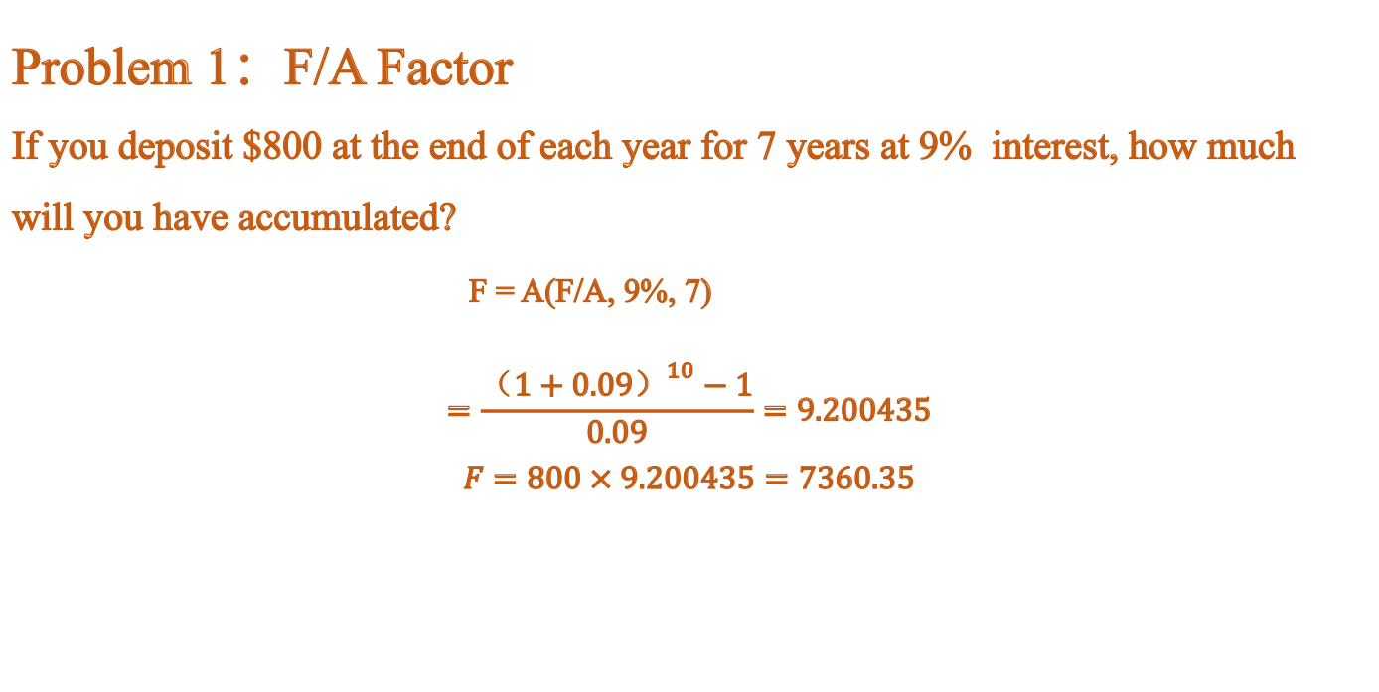
Problem 1：F/A Factor
If you deposit $800 at the end of each year for 7 years at 9% interest, how much will you have accumulated?
F = A(F/A, 9%, 7)
$$=\frac{{（1+0.09）}^{10}−1}{0.09}=9.200435$$
$$F=800×9.200435=7360.35$$

Slide 24
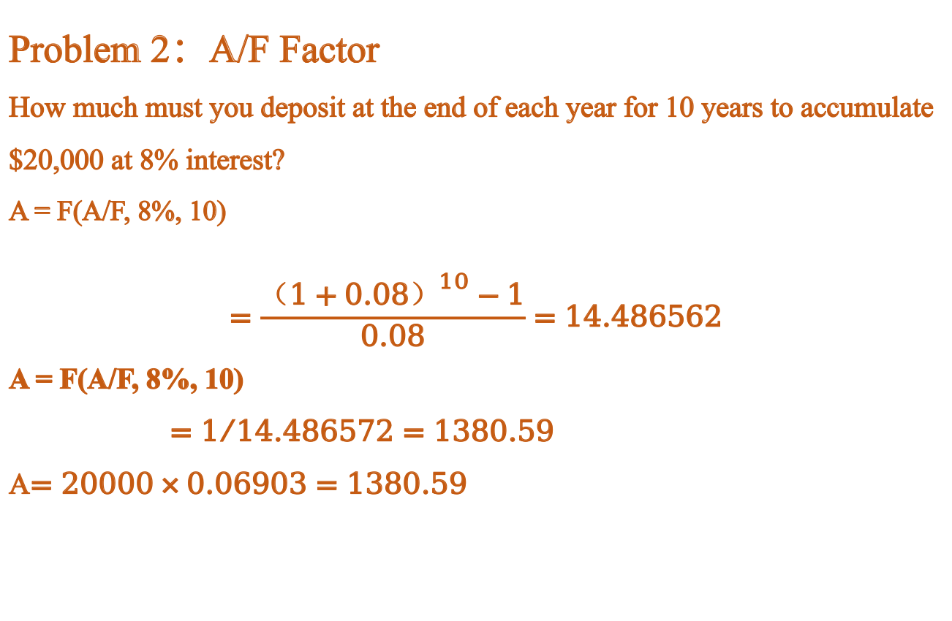
Problem 2：A/F Factor
How much must you deposit at the end of each year for 10 years to accumulate $20,000 at 8% interest?
A = F(A/F, 8%, 10)
$$=\frac{{（1+0.08）}^{10}−1}{0.08}=14.486562$$
A = F(A/F, 8%, 10)
$=1/{14.486572}=1380.59$
A$=20000×0.06903=1380.59$
输入标题

Slide 25
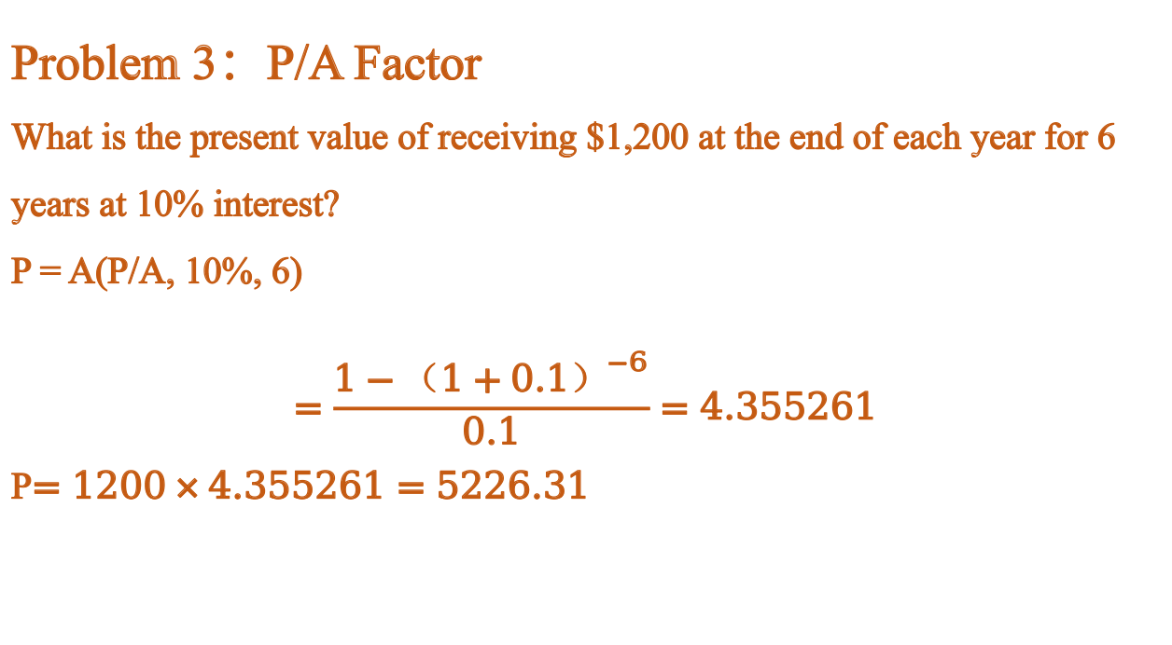
Problem 3：P/A Factor
What is the present value of receiving $1,200 at the end of each year for 6 years at 10% interest?
P = A(P/A, 10%, 6)
$$=\frac{{1−（1+0.1）}^{−6}}{0.1}=4.355261$$
P$=1200×4.355261=5226.31$

Slide 26

Problem 4：A/P Factor
A loan of $15,000 is to be repaid in equal annual payments over 5 years at 12% interest. What is the annual payment?
A = P(A/P, 12%, 5)
$$=\frac{{0.12（1+0.12）}^{5}}{{（1+0.12）}^{5}−1}=0.27741$$
$$A=15000×0.27741=4161.15$$

Slide 27
Chapter 3 补充

Slide 28
国家无风险利率:1.75%左右
美联储利率:3.5%-4%左右
风险等级的判定：
R1 低风险 本金损失概率极低，收益波动极小
活期存款、国债、货币基金（余额宝）、国债逆回购
R2 中低风险 本金亏损概率较低，收益有一定波动
纯债基金、银行 R2 级理财、短债基金
R3 中等风险 不保本，本金存在一定亏损可能
混合债基、可转债基金、部分固收+理财、黄金
R4 中高风险 本金亏损概率较高，波动剧烈
股票型基金、指数基金、私募证券基金
R5 高风险 可能损失全部本金，甚至产生额外负债
期货、期权、数字货币、PE/VC、原油宝类衍生品
基准在 1.5%～2.8% 之间 → R1/R2 低风险。
基准在 3.5%～5.0% 之间 → R3 中风险。
基准 6% 以上 → R4/R5 高风险。
美联储利率看着很高，为什么不去存钱？
1.美联储不对个人、普通商业机构开放储蓄业务
不接受个人、普通企业开户存钱。
2. 存款主体资格限制只有美国合规的存款类银行、特定金融机构，才可以在美联储开设准备金账户、存放资金并赚取准备金利率。
3. 资金体量门槛极高即便有资格准入，存放的也都是巨额银行准备金，不是零散私人资金。
4. 额外限制美联储账户没有普通银行的存取、支付、日常结算功能，完全不适合日常资金存放。
5. 替代方式普通人想要锚定美联储利率，只能通过购买美国短期国债、货币市场基金等间接方式来获取接近美联储政策利率的收益。

Slide 29
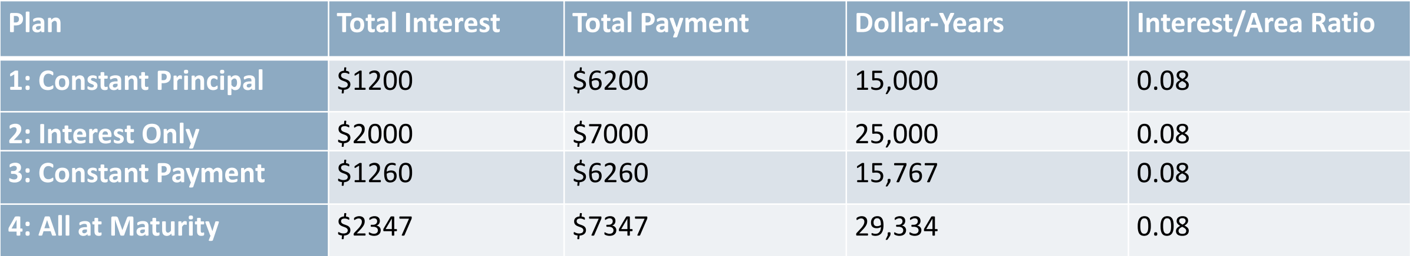
Repaying a Debt: Four Plans
$5000 is owed and to be repaid in 5 years with 8% annual interest.
Four Repayment Plans:
•Plan 1: Constant Principal / 等额本金
Pay $1000 principal + interest due each year
•Plan 2: Interest Only / 只付利息
Pay interest only for 4 years, then principal + interest in year 5
•Plan 3: Constant Payment / 等额还款
Pay five equal end-of-year payments of $1252
•Plan 4: All at Maturity / 到期一次性
No payments until end of Year 5, then pay everything /

Slide 30
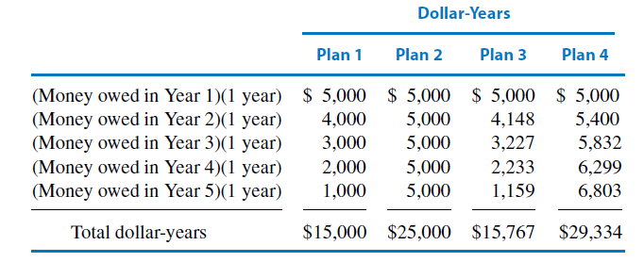
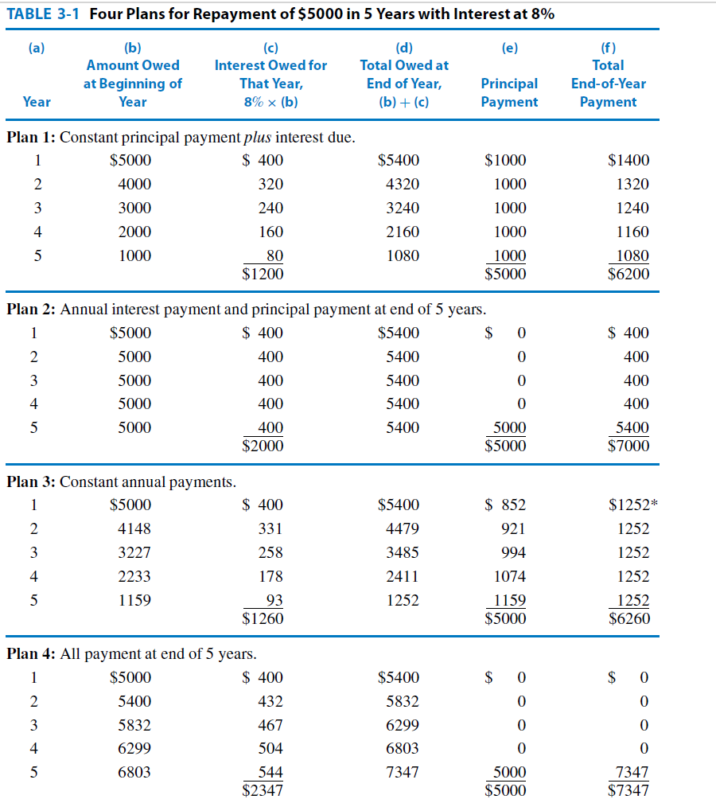

Slide 31
$5000 is owed and to be repaid in 5 years with 10% annual
Plan 1: Constant Principal / 等额本金
Pay $1000 principal + interest due each year
5000 ×10%=500 +1000
4000 ×10%=400 +1000
3000 ×10%=300 +1000
2000 ×10%=200 +1000
1000 ×10%=100 +1000
1500 + 5000=6500
Dollar-Year:5000+ 4000+ 3000+ 2000+ 1000=15000
Interest/Area Ratio:1500/15000=0.1
Plan 2: Interest Only / 只付利息
Pay interest only for 4 years, then principal + interest in year 5
500 ×5=2500
2500 +5000 =7500
Dollar-Year:5000×5=25000
Interest/Area Ratio:2500/25000=0.1

Slide 32
Plan 3: Constant Payment / 等额还款
Pay five equal end-of-year payments of $1319
5000 ×10%=500 +(1319-500)=500+819
4181 ×10%=418.1+(1319- 418.1)= 418.1+900.9
3280.1 ×10%=328.01+(1319-328.010=328.01+990.99
2289.11 ×10%=228.911+(1319-228.911)=228.911+1090.089
1199.021 ×10%=119.9021+(1319-119.9021)= 119.9021+1199.0979
Dollar-Year:5000+ 4181 + 3280.1 + 2289.11 + 1199.021 =15949.231
Interest/Area Ratio:（ 500 + 418.1 + 328.01 + 228.911 + 119.9021 ）/ 15949.231 =1594.9231 / 15949.231 =0.1
Plan 4: All at Maturity / 到期一次性
No payments until end of Year 5, then pay everything
5000 ×10%=500
5500 ×10%=550
6050 ×10%=605
6655 ×10%=665.5
7320.5 ×10%=732.05
Dollar-Year:5000+ 5500 + 6050 + 6655 + 7320.5 =30525
Interest/Area Ratio:3052.55/30525=0.1

Slide 33
